Slide 1
Design of SEM in Courses
BIOTECH
MUSIC
ARTS
BOTANY
MATHEMATIC
COMMERCE
PROf. S. V. DUDUL,
I/C DEAN (Science & TECH)
SGBAU, AMRAVATI
PHYSICS

Slide 2
CBCS UG non-professional Programmes
Semester I
Compulsory English – I
Compulsory English – II
Communication Skills in English (AEC)
Second Language- I
Communication Skills in 2nd Lang (AEC)
DSC 1, 2, 3, …
DSC 1, 2, 3 Pract
GOEC 1
*OEC/GIC
Induction Programme
Semester II
Communication Skills in English (AEC)
Second Language - II
Communication Skills in 2nd Lang (AEC)
DSC 4, 5, 6, …
DSC 4, 5, 6 Pract
GOEC 2
*OEC/GIC
Internship
Internship
Internship/Apprenticeship/Field Work/ Work Experience
Open Elective/GIC/Open Skill/MOOC
Concerned BOS to identify and suggest Courses for DSC, DSE, OEC, Open Skill, MOOC, GIC, etc.
Internship: 150 Hours (5 Credits)
SEM included in every
DSC and DSE as an Additional Unit

Slide 3
Internship/Apprenticeship/Field Work/Work Experience
Open Elective/GIC/Open Skill/MOOC
A course on IPR either in Sem III or in Sem IV along with a mandatory Project
Concerned BOS to identify and suggest Courses for DSC, DSE, AEC on DSC, SEC
Internship: 60 to 90 Hours (Min 2 & Max 3 Credits)
CBCS PG non-professional Programmes
Semester I
DSC 1,2,3,4…
Semester II
DSC 5,6,7, …
DSC 1,2,3, … Lab/Pract
AEC on DSC
Internship/ …
OEC/ GIC…
DSE 1
DSC 5,6,7, … Lab/Pract
DSE 1 Lab/Pract
AEC on DSC
Internship/…
OEC/GIC…
Scheme of CBCS PG non-professional Programme

Slide 4
POs
PSOs
Employability
COs
UNITS

Slide 5
SEM
COs of SEM
Activities
Course Material

Slide 6
Skills Enhancement Module (SEM):-
SEM in each Course of DSC and DSE.
No SEM for GOEC and Environmental Studies.
SEM assessed as an internal evaluation (20% of total marks) through Activities/Tasks/Mini- Projects/Assignments, etc.

Slide 7
SEM designed for
Application of Theory in Practice
To increase the employability of the student
To provide requisite skill to the students

Slide 8
Skills to be imparted/enhanced through SEM
A. Cognitive/
Intellectual Skills
B. Procedural/
Psychomotor Skills
C. Communication Skills
D. Team Skills
A. Cognitive
B. Procedural
C. Communication
D. Team

Slide 9
BOS: Design of SEM
COs of every DSC/DSE and also SEM
1. Specific,
2. Measurable and
3. Achievable

Slide 10
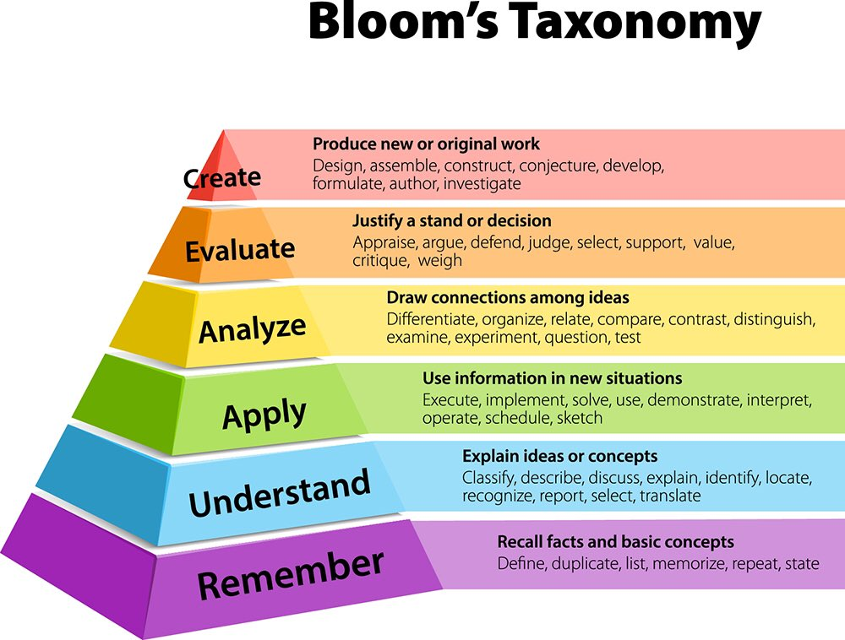

Slide 11
Bloom’s Taxonomy
Bloom’s Level | Key Verbs (Keywords)
?Understand | describe, explain, paraphrase, restate, give original examples of, summarize, contrast, interpret, discuss.
√Apply | calculate, predict, apply, solve, illustrate, use, demonstrate, determine, model, perform, present.

Slide 12
Bloom’s Taxonomy
Bloom’s Level | Key Verbs (Keywords)
√Analyze | classify, categorize, analyze, diagram, illustrate, criticize, simplify, associate.
√Evaluate | choose, relate, determine, defend, judge, grade, compare, contrast, argue, justify, convince, select, evaluate.
√Create | design, formulate, build, invent, create, compose, generate, derive, modify, develop.

Slide 13
Employability
Skills
SUCCESS
Workspace Skills
Applied Knowledge
Effective Relationships

Slide 14
Effective Relationships
Interpersonal
Skills
Personal Qualities

Slide 15
Workspace Skills
1
RESOURCE MANAGEMENT
2
INFORMATION USE
3
COMMUNICATION SKILLS
4
SYSTEMS THINKING
5
TECHNOLOGY USE

Slide 16
Applied Knowledge Skills
Critical Thinking
Skills
Applied
Academic
Skills

Slide 17
Identify Employability Skills in a DSC/DSE
Employability Skills
Interpersonal Skills
Personal Qualities
Resource Management
Information Use
Communication Skills
Systems Thinking
Technology Use
Applied Academic Skills
Critical Thinking Skills
Outcomes :
What do you want students to learn or experience in the course?

Slide 18
Communication/People Skill
Advertize | Contact | Judge | Recruit | Convince
Author | Debate | Mediate | Summarize | Edit
Compose | Persuade | Outline | Speak | Compere
Arrange | Interpret | Publicize | Translate

Slide 19
Creative Skills
Conceptualize | Model
Create | Photograph
Design | Direct
Draw | Formulate

Slide 20
Data/Financial Skills
Assess | Plan | Estimate
Calculate | Manage | Measure
Analyze |  | Program

Slide 21
Helping Skills
Advocate | Educate | Simplify
Clarify | Cooperate | Help
Collaborate | Facilitate | Represent
Demonstrate | Support

Slide 22
Management/Leadership Skills
Coordinate | Delegate | Hire | Preside
Direct | Control | Supervise | Select
Improve | Chair | Lead | Inspect
Reorganize | Execute | Produce | Navigate

Slide 23
Organizational Skills
Arrange | Distribute | Process
Categorize | File | Register
Classify | Organize | Validate
Collect | Monitor | Screen
Correct | Operate

Slide 24
Research Skills
Critique | Experiment | Measure
Compare | Extract | Research
Search | Investigate | Systematize
Determine | Interview | Summarize
Evaluate

Slide 25
Technical Skills
Apply | Determine | Regulate
Build | Engineer | Repair
Compute | Maintain | Restore
Construct | Overhaul | Utilize
Debug | Program

Slide 26
Teaching Skills
Advise | Evaluate | Persuade
Coach | Facilitate | Stimulate
Conduct | Guide | Test
Coordinate | Inform | Transmit
Enable | Instruct

Slide 27
Some examples for outcome of SEM
Review and Critics of Literature/classic texts, poems, drama, epics, etc.
Succinct Summarization of Literature/classic texts, poems, drama, epics, etc.
Translation into other language
Write scripts for documentary movies, drama, movies, news, advertisement, TV channels, radio, short films, TV serials, web series, brochure, articles, animation, blogs, websites, video, storytelling, resume, agenda of meeting, minutes of meeting, social media (Tweeter, Instagram, Facebook, WhatsApp, etc.) , etc.
Conduct off-line and on-lines Surveys (market research for a product, recent trends, etc.

Slide 28
Please visit the following sites for details https://nsdcindia.org/sector-skill-councils https://nsdcindia.org/nos-listing/24
A GUIDE FOR SEM

Slide 29
Profound Gratitude to Dr. Dileep N. Malkhede Sir, Honourable Vice Chancellor, Sant Gadge Baba Amravati University for his enthusiastic, inspiring and invaluable guidance as well as compassionate support.
Thank You

